Slide 1
Code Quality Analysis in Azure DevOps Pipelines
Vahid Farahmandian

Slide 2



Who am I?
Vahid Farahmandian
Born in Urmia @ 1989
BSc Computer Software Eng, Urmia Uni.
MSc Medical Informatics, Tarbiat Modares Uni.
International Speaker & Author
Creator member of WeAreDotnet Community
CEO @ Spoota
Instructor @ FAD.ir

Slide 3







Develop
IntelliJ
Eclipse
V.Farahmandian@jinget.ir
VahidFarahmandian
VFarahmandian
Contact Me
VahidFarahmandian
_jinget
Collaborate
Operate
Deliver
jinget.medium.com
Ansible
Chef
ELK Stack
Grafana
Puppet
Jenkins
Maven
Packer
Terraform
Jinget dot Net
Notes:
Not only do you get the most productive Developer and DevOps tools and platforms with GitHub and Microsoft Azure
But, because these are integrated with Microsoft Azure, you can deploy to and take advantage of our 140+ services that we have for your use
This is not a complete listing of all the of the services, but highlights some of the key/main areas that you can utilize to accelerate your innovation
You can deploy to our core infrastructure, or advanced platform as service workloads such as Azure Functions and Azure Kubernetes service
As well as leverage Microsoft and open source data solutions, AI and cognitive services
As well as extending your applications across Azure Stack and Hybrid deployments

Slide 4
Defining Quality
One of the primary goals of the DevOps mindset, is increasing the flow of value to end users.
To do this, software must be deployed frequently, maybe even multiple times per day.
To make frequent deployments possible, two things are important:
Automation
Quality

Slide 5
Defining Quality
Quality: The totality of features and characteristics of a product or service that bear on its ability to satisfy given needs.
What actually makes quality sufficient can differ from project to project.
Before quality can be measured, it is important that you first establish how to measure the quality of software.
A common approach to monitoring the quality of software is to gather one or more metrics

Slide 6
Some metrices for quality
The percentage of integration builds that fails
The percentage of code covered by automated tests
The change failure rate
The amount of unplanned work
The number of defects that are being reported by users
The number of known issues
The amount of technical debt

Slide 7
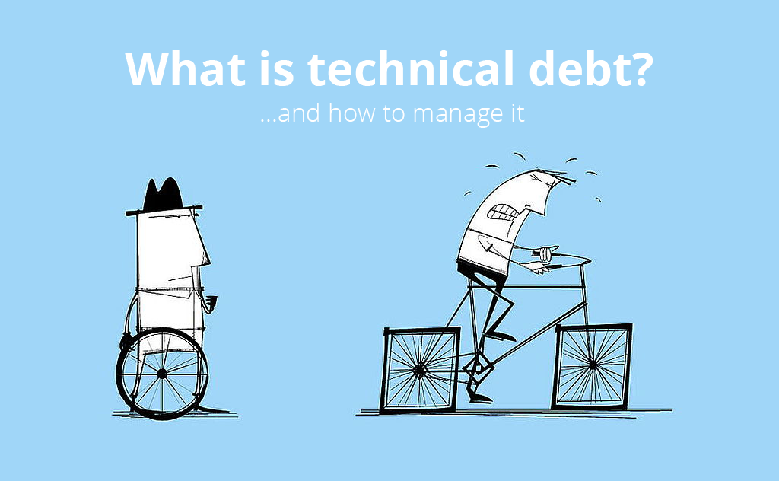
Technical debt
The term "debt" implies that something (time, quality, attention, or work) is owed to the solution. So long as this debt is not paid off, you have to pay interest in the form of all other work being slowed down a little bit

Slide 8
Technical debt
Code that is not covered by any unit test
Code that is not written in a self-explanatory fashion
Code that does not adhere to coding principles
Classes that are too complex because they have too many variables and methods
Methods that are too complex because they have too many statements

Slide 9
Technical debt
If you want to quickly create some code, you take a loan on quality. When you want to pay back your loan, you pay interest in the form of extra maintenance costs.
But when technical debt skyrockets, the interest becomes so large that it can strangle your project. That’s the point where developers want to start from scratch and rewrite everything.
Taking a loan can sometimes be a good decision
It stays important that you know where the technical debt is and how much it is

Slide 10
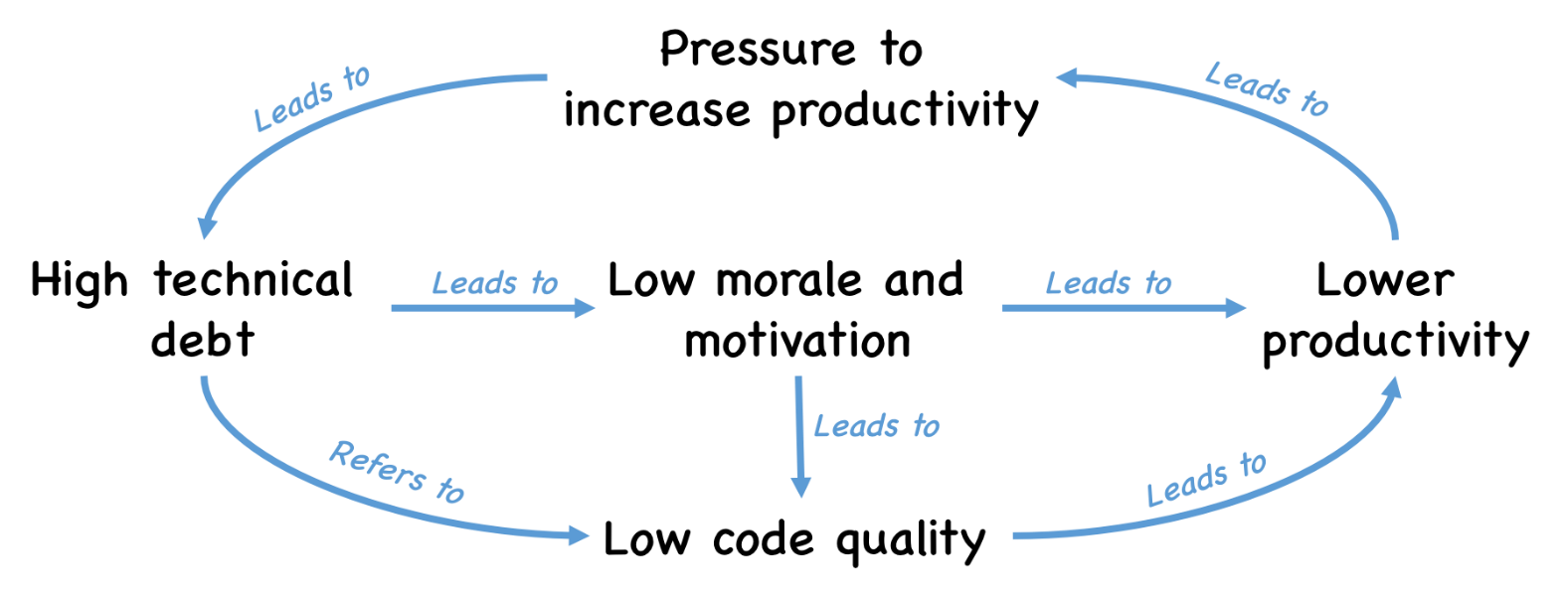
Technical debt

Slide 11
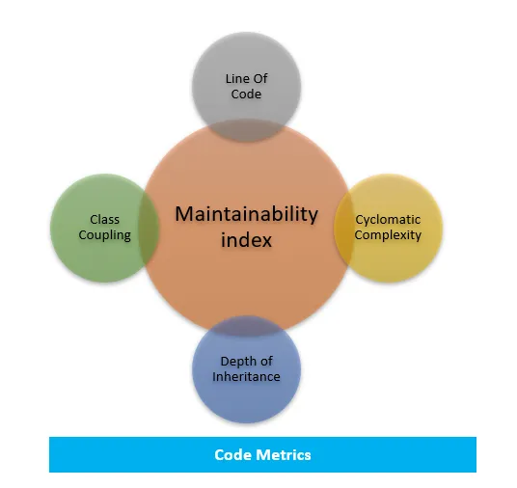
Technical debt-code metrics
Lines of code
Cyclomatic Complexity
Coupling
Inheritance

Slide 12
Thank you

